Slide 1
Finding the longest common subsequence for multiple biological sequences by ant colony optimization
Shyong Jian Shyu, Chun-Yuan Tsai
Computers & Operations Research 36 (2009) 73 – 91
Speaker: Chun-Jen Chen
Date: July 3, 2008

Slide 2
Abstract
Finding the longest common subsequence (LCS) for a set of n (an arbitrary n>2) sequences is an NP-hard problem. It is an essential operation for a wide range of applications in the areas of computational biology, pattern recognition, string editing and data compression, to name a few. In this paper, we design a novel ant colony optimization (ACO) algorithm to find the approximate solution to the LCS problem for multiple biological sequences. The performances of our ACO algorithm, the known expansion algorithm [Bonizzoni P, Vedova GD, Mauri G. Experimenting an approximation algorithm for the LCS. Discrete Applied Mathematics 2001;110:13–24]
115/11/07

Slide 3
Abstract
and best next for maximal available symbol algorithm [Huang KS, Yang CB, Tseng KT. Fast algorithms for finding the common subsequence of multiple sequences. In: Proceedings of international computer symposium; 2004. p. 90–95] were tested and compared by using various sets of DNA and protein sequences. The experimental results demonstrate the effectiveness and efficiency of the proposed ACO algorithm in dealing with the LCS problem for multiple biological sequences.
115/11/07

Slide 4
LCS For Multiple Sequences
S1 = babacd
S2 = acdcbc
S3 = adcbc
LCS of S1, S2, and S3 is abc

Slide 5
Problem Transformation
Randomly choose m (m<n) sequences
R={s1,s2,….,Sm}
One particular artificial ant, say ant a_{r}, is assigned to sequence s_{r} ∈ R (1≦r≦m). a_{r} constructs its own solution by traversing sr.

Slide 6
Problem Transformation
S1 = babacd
S2 = acdcbc
S3 = adcbc
R={S1}
States = (b,1) (a,2) (b,3) (a,4) (c,5) (d,6)
Ex. state (b,1) is not good enough since the LCS that it leads to is bc

Slide 7
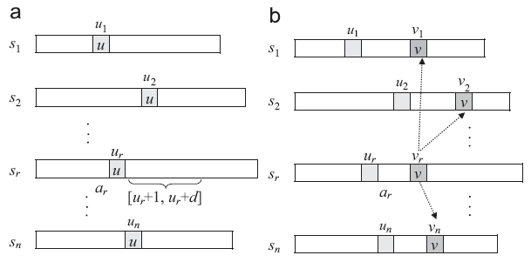
State Transition Rule

Slide 8
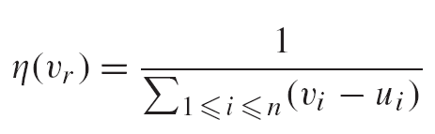
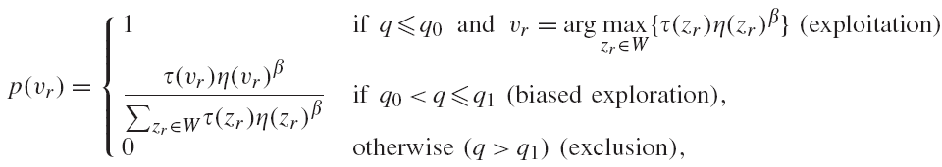
State Transition Rule
Consist of 2 components:
The pheromone intensity
The heuristic value

Slide 9



Pheromone Updating Rule
Where i,j is random selected from 1~n

Slide 10
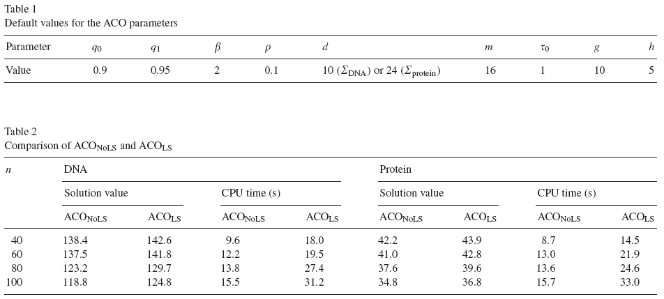
Experimental results

Slide 11
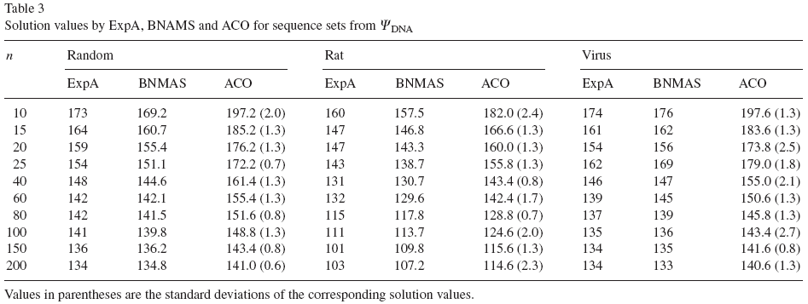
Experimental results

Slide 12
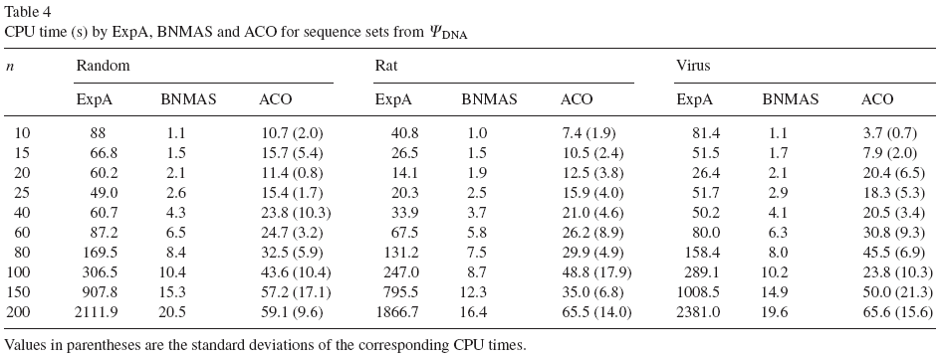
Experimental results

Slide 13
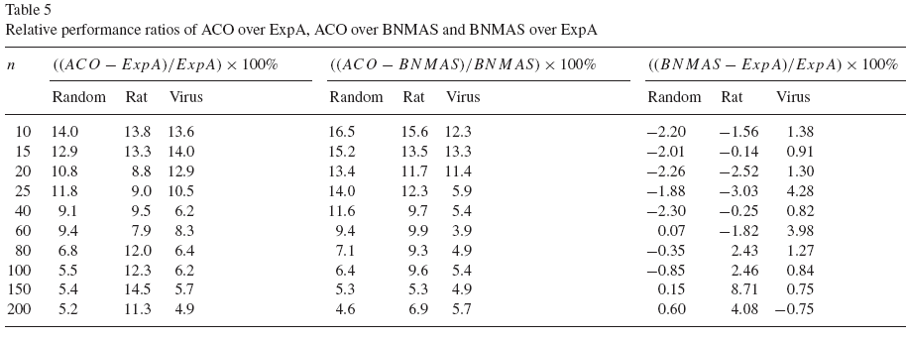
Experimental results

